Slide 1
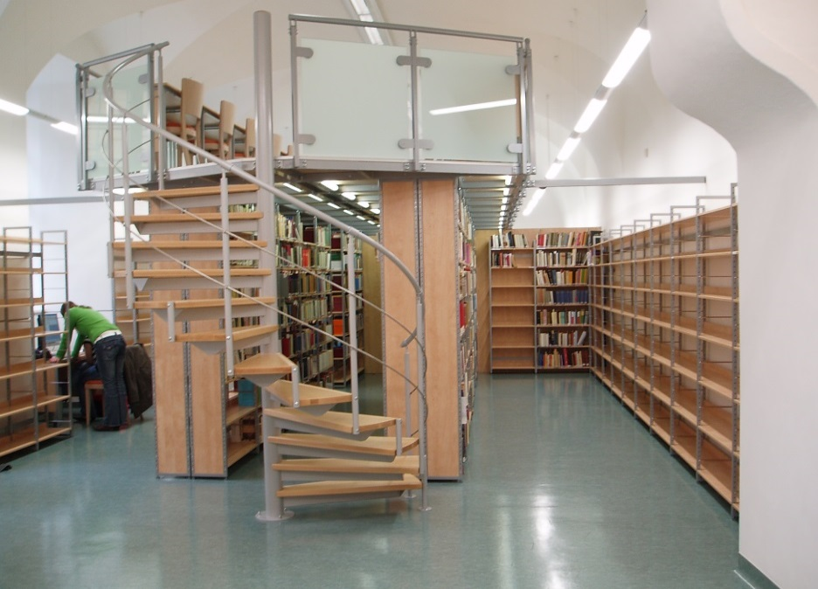
The Library of Sts Cyril and Methodius Faculty of Theology
Guide for International Students

Slide 2
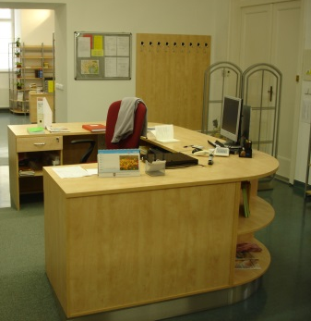
Staff
Mgr. Hana Frycová – manager
Mgr. Petra Juráňová
Mgr. Jiří Piáček
Mgr. Lada Polláková

Slide 3
Office Hours
Mon 9:00 – 18:00
Tue 9:00 – 16:00
Wen 9:00 – 16:00
Thu 9:00 – 18:00
Fri 9:00 – 13:00
(Sat 9:30 – 13:30 when
faculty is open)

Slide 4
Professional Profile of Library Fund
teology
philosophy
liturgy
history
sociology
law
psychology
education etc.

Slide 5
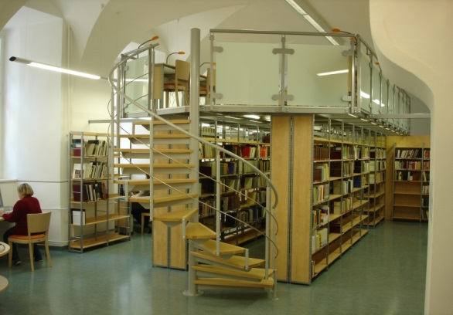
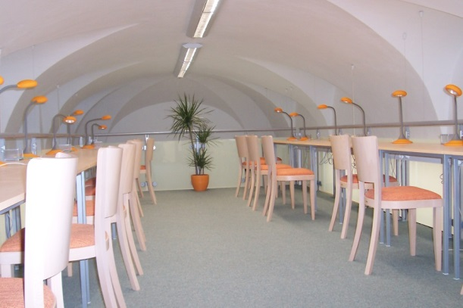
Equipment
29 study places
Internet connection
(wireless as well as through cable)
Copy machine
Scanner
2 multimedia workplace (TV, DVD, videorecorder).

Slide 7
Book Categories
Reference Section - it‘s not possible to take these books away from the library. (Books with red label.)
External loan books - it‘s possible to borrow them on 30 days. This period can be renewed when there aren‘t any reservation on the borrowed materials. (Books with white label.)
Items for short-term borrowing – 14 days
(fiction in the Central University Library)

Slide 8
How many books can you borrow and for how long?
You can borrow up 15 items (books, documents etc., altogether from all the libraries of Palacký University).
The books are lent usually for 30 days.
You can renew this period thrice.

Slide 9
Penalties
For every day that exceeds the agreed loan period you pay a penalty of 2 Czk per each borrowed item (books and other documents).

Slide 10
To borrow a book in our library you need an ISIC!
ISIC serves as your library member card.
You can also use it for copying and printing
using a pre-paid credit.
(see Self-Service Copying and Printing below)

Slide 11
Important Information
Palacký University Library sends information (especially regarding reservations of books and the upcoming deadline of the loan period) only to university e-mail addresses. It means that YOU HAVE TO USE YOUR UNIVESITY E-MAIL (accessible through your portal login).
Reminders are also sent through the university e-mails (in case you don‘t return the borrowed books in time).
Any user can arrange re-sending of the university e-mails to his/her private e-mail address:
http://portal.upol.cz -> Administration -> Help and guidelines -> University e-mail -> E-mail for students ->

Slide 12
Self-Service Copying and Printing
The credit bought in the Sts Cyril and Methodius Faculty of Theology may be used within the whole Palacký University
for printing and copying.
1 copy A4 = 1.20 CZK
NOTE: Don‘t confuse with credit for meals in student dining halls!

Slide 13
Sale of books
There you can purchase selected titles released CMTF UP in the library of Sts Cyril and Methodius Faculty of Theology
The price list is hanging up on the bulletin board to the left of the door to the library.

Slide 14
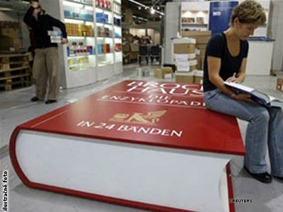
We wish you a lot of success in your studying and a pleasant time when using our library!

